Slide 1

Secure ESP-now
Personal research project
Jovan Christopher

Slide 2
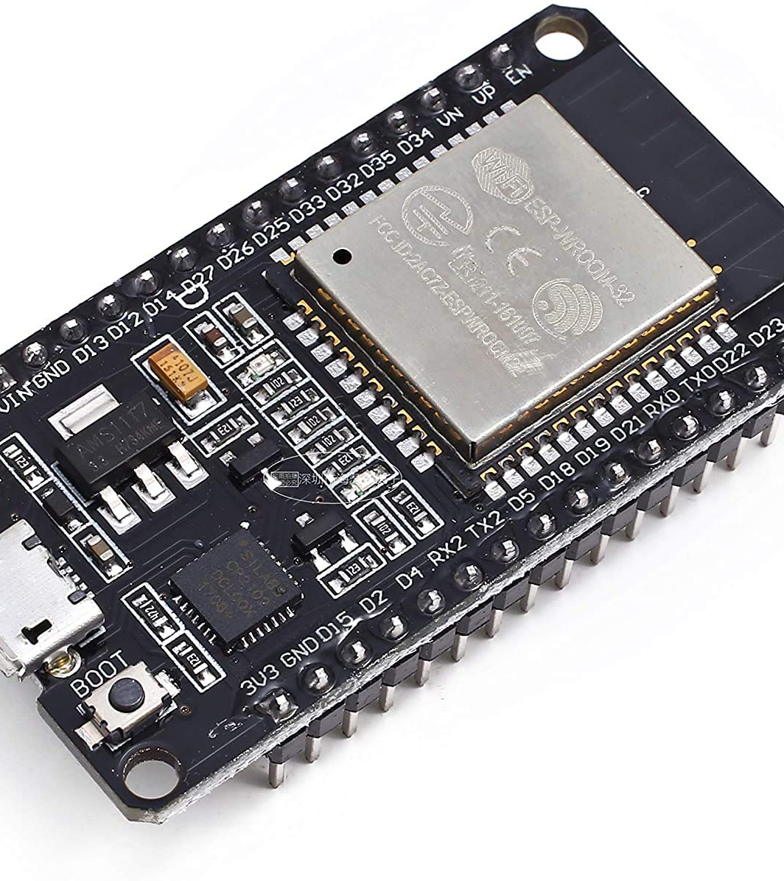
Agenda
Introduction
Research Questions
Tests and Experiments w/ demo
Implementation w/ demo
Research Questions Answers
BoK Implementations
Summary and Questions

Slide 3

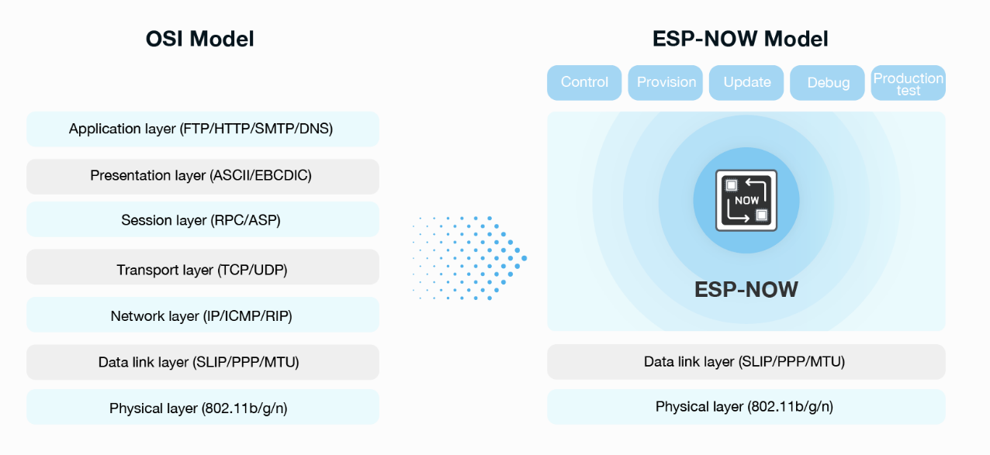
INTRODUCTION
What is ESP-NOW?
Wireless communication based on data-link layer
Developed by Espressif Systems
2.4 GHz band
Released in 2022
Notes:
Doesn’t need to go all the way through the layers
No need packet headers and unpackers reducing delay caused by packet loss in congested network

Slide 4
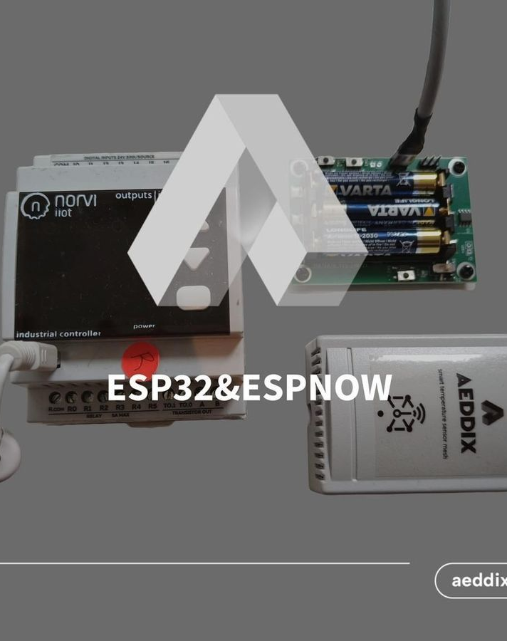
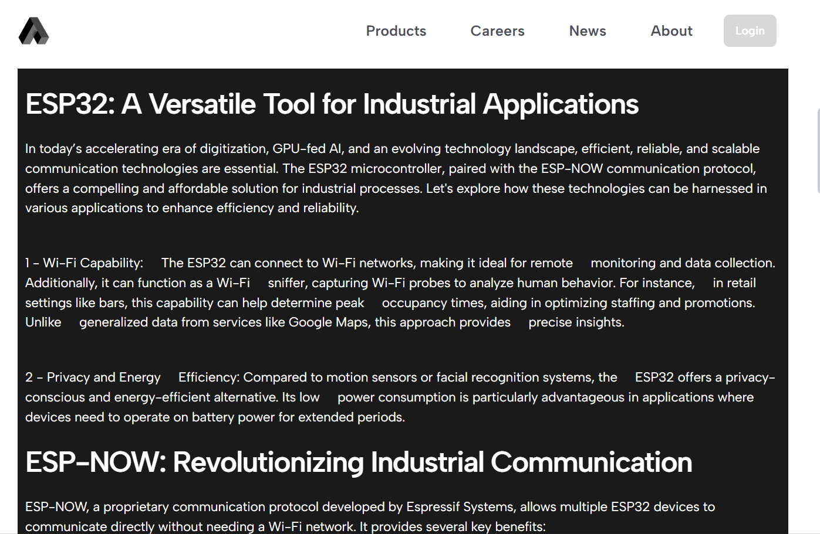
INTRODUCTION
Real-Life Application
Aeddix Systems GmbH published a news article regarding the use of ESP-NOW
Image source: https://www.aeddix.com/blog/the-rise-of-esp32-and-esp-now-for-industrial-automation
Notes:
Austrian company

Slide 5


Introduction
Real-Life Application
Seeed Studio created “MicroMote” based on ESP-NOW
Gesture remote for smart devices
Source: https://www.seeedstudio.com/blog/2023/12/11/revolutionizing-remote-control-explore-micromote-an-esp-now-based-gesture-remote-with-xiao-esp32s3-and-smart-gesture-sensor/

Slide 6

Introduction
Real-Life Application
Nozomi Networks, Cybersecurity company founded in Switzerland
Published a protocol analysis and vulnerability research on ESP-NOW in September 2024
Important vulnerability: replay attacks even on encrypted packets (CVE-2024-42483)

Slide 7

Research Questions
How to improve ESP-NOW reliability by providing a secure transfer of data?(Brainstorm)
What are the potential vulnerabilities of ESP-NOW and how to exploit it? (Community Research and Literature Study )
How to sniff or intercept data being transmitted through ESP-NOW? (Community Research and then implement Security Tests)
What security measures could be implemented?(Community Research, Literature Study, and Available Product Analysis. Implementation will then be conducted while using System Tests, Code Review, and Prototyping)

Slide 8

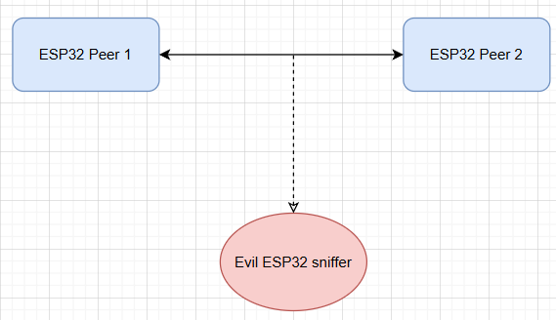
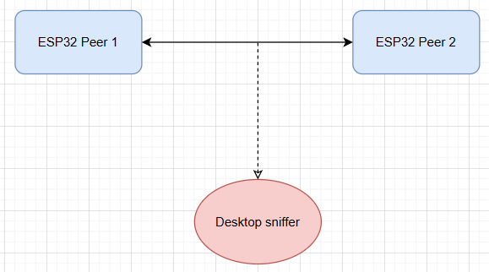
Tests and experiments
Initial Attack Plans(before testing)

Slide 9
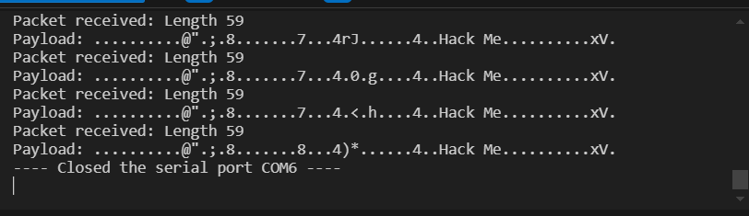
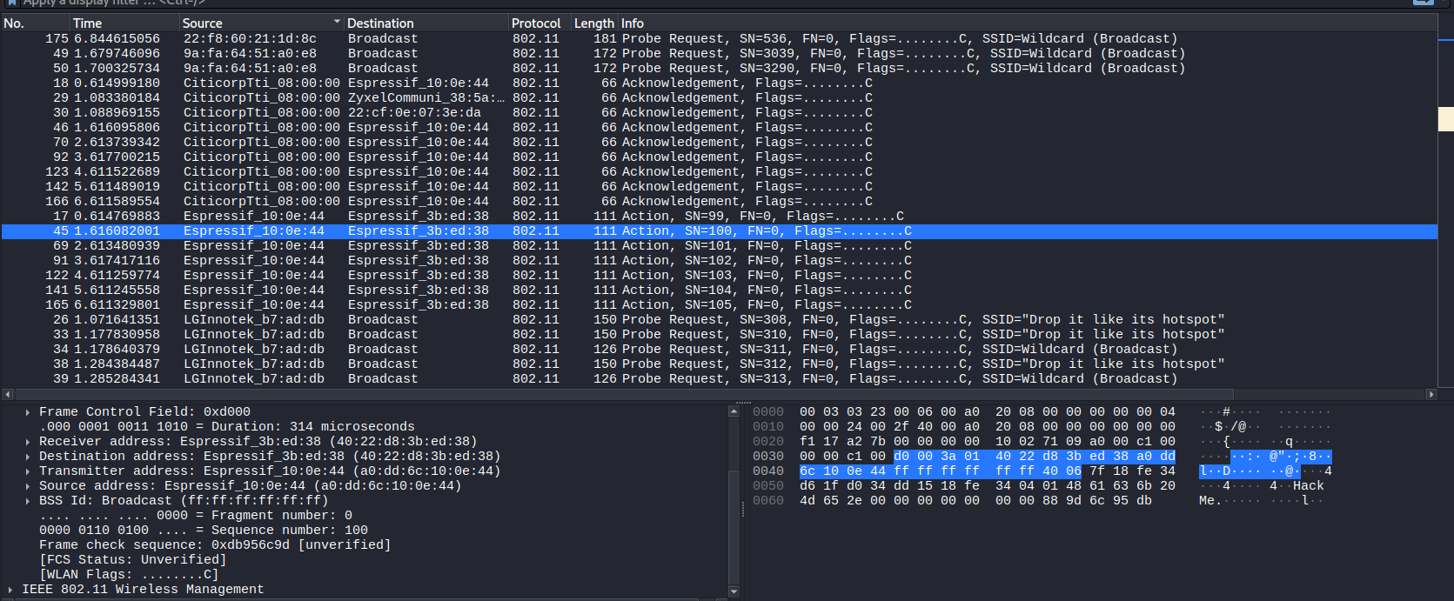
Tests and experiments
First phase results
ESP-32s could sniff with its promiscuous mode but is unable to capture the whole packet.
ESP-32’s sniffing couldn’t determine the protocol of the packets.
Packet length captured by ESP-32 and Wireshark are different, due to the reason explained in the first statement.

Slide 10
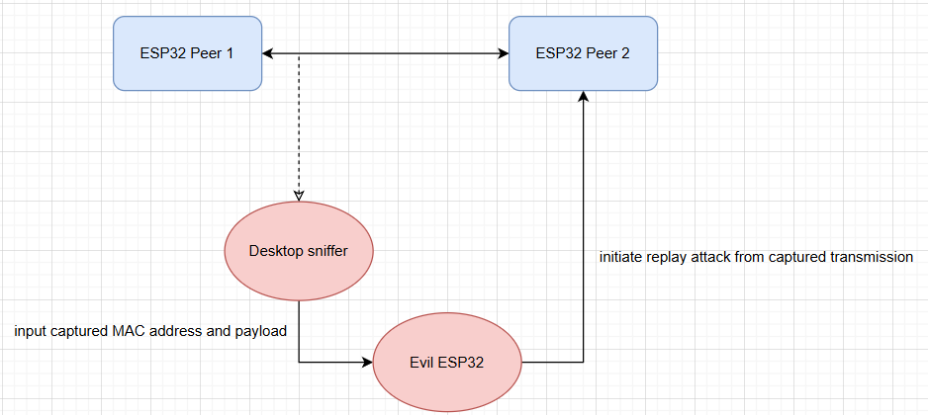
Tests and Experiments
Revised Attack Plan

Slide 11
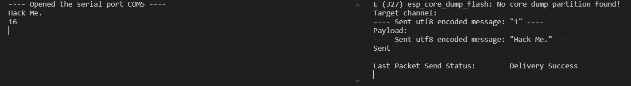
Test and experiments
Successful replay attack on unencrypted ESP-NOW transmission
Combination of Wireshark and ESP32

Slide 12

Implementation
Using the built-in ESP-NOW encryption(patched)
According to Nozomi Networks, not long after they discovered the vulnerability, Espressif has patched the vulnerability
Source: https://www.nozominetworks.com/blog/flaws-in-espressif-esp-now-allow-attackers-to-replay-communications

Slide 13
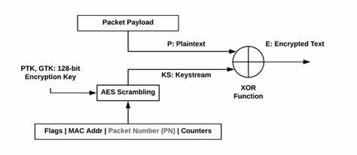
CCMP with AES-128
Standard security provided by Espressif’s ESP-NOW library
Replay attack vulnerability fixed in ESP-NOW 2.5.2
Providing up to 16 bytes of encryption key(both PMK and up to 6 LMK)

Slide 14

Research Questions(Answers)
How to improve ESP-NOW reliability by providing a secure transfer of data?
Implementing message encryption and authentication while making sure that a self-generated encryption key of 16 bytes is used.
What are the potential vulnerabilities of ESP-NOW and how to exploit it? Replay attack vulnerability persists although the risk is lower after the fix, out of bounds memory read. Exploiting encrypted ESP-NOW could be done by intercepting raw packets and retransmitting the packet to the destination node, however this needs deep understanding of the protocol and lots of experience.
How to sniff or intercept data being transmitted through ESP-NOW? Wireshark or any other network analysis/sniffer software can be used including an ESP-32.
What security measures could be implemented? Basic security: built-in security by ESP-NOW using CCMP and AES-128. Advanced security: lots of encryption and authentication library to be used in combination with ESP-NOW such as ChaCha20 and GCMP however in the world of embedded systems memory is a scarce resource most of the time so deciding on a protocol that is not overkill is important.

Slide 15

BoK implementation
Network Scanning (Offensive)
Radio Hacking (Offensive)
Network Spoofing and MITM (Offensive)
Common Vulnerabilities and Exposures (Defensive)
Secure Software Design (Defensive)
Encryption and Authentication (Defensive)

Slide 16
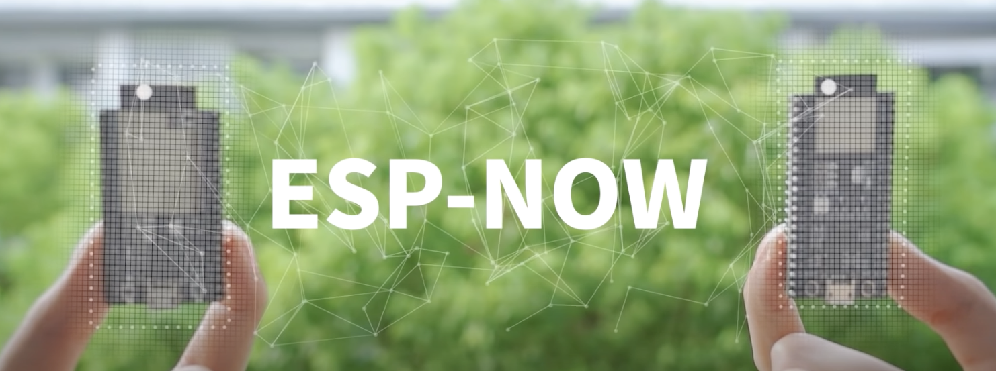
Summary and Questions
Importance of encryption and authentication in wireless communication
Security in IoT
Implementing a secure data transfer by design

